Slide 1
KAGGLE DATA MINING COMPETITION
BANKRUPTCY ANALYICS
CHUNXUAN ZHANG

Slide 2
CONTENTS
WORKING FLOW
TUNING AND IMPROVING
LEARNT AND IDEA
PART ONE
PART TWO
PART THREE

Slide 3
WORKING FLOW
Fail: Random Forest, logit Regression, deep learning​
Model Selection
H2o package: automl: xgboost​
Fail: Under-sampling, over-sampling​
Data Balance Method
SMOTE: Better!​
Unsupervised learning and generates new data!​
Why not filter out Attributes or Outliers
Attributes and Data may contain information out of box
Grid Search
vs.
Manually Tuning Model​
Manually: Work-load & hard to compare model​​
Grid Search: Effective - search best model and visualize result​

Slide 4
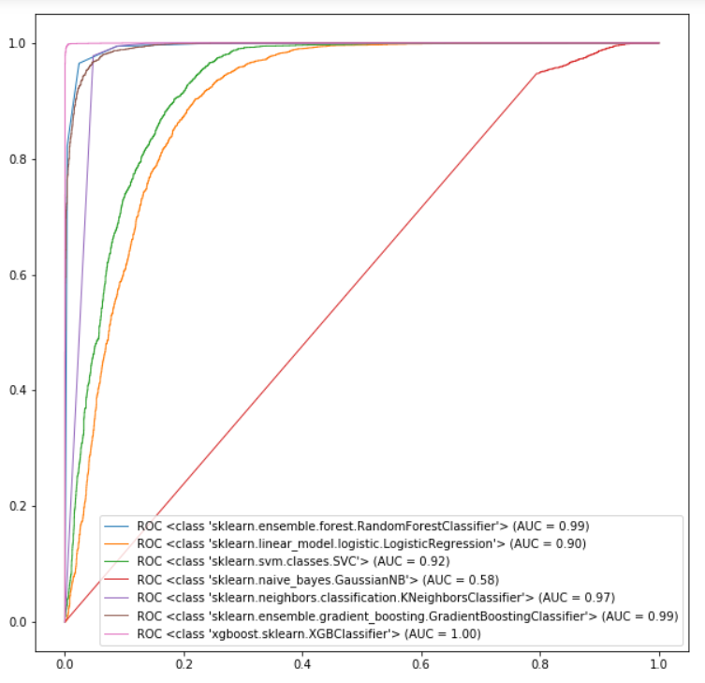
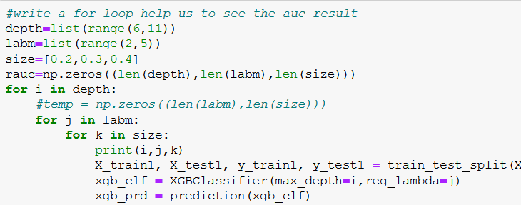
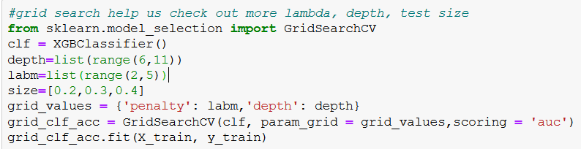
TUNING AND IMPROVING​
Train size: Test Size = 60: 40 XGBoost: depth = 8

Slide 5
What I learnt​
Further ideas​
New techniques:​
SMOTE​
Xgboost​
Grid Search
Tuning SMOTE​
Learn more about Attributes​
AdaBoost​

Slide 6
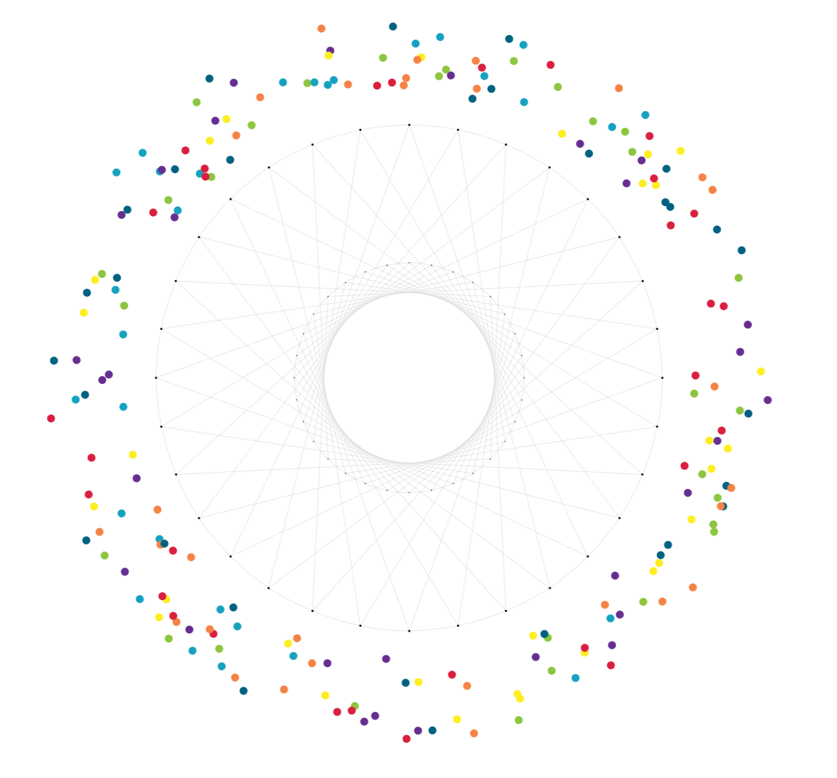
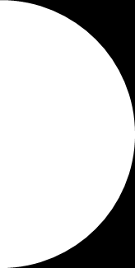
Q&A

